Slide 1
Mining Heterogeneous Information Networks
Jiawei Han
Computer Science
University of Illinois at Urbana-Champaign
February 4, 2017

Slide 2
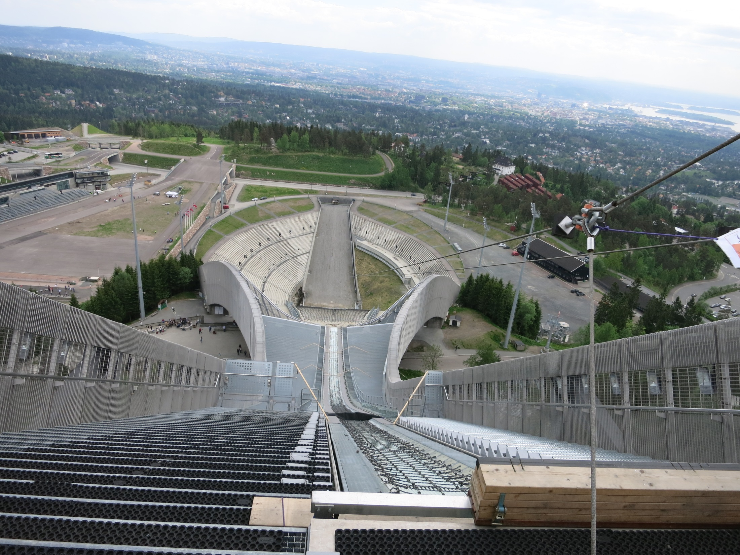

Slide 3
Outline
Motivation: Why Mining Information Networks?
Part I: Clustering and Ranking in Heterogeneous Information Networks
Clustering and Ranking in Information Networks
Similarity Search in Information Networks
User-Guided Meta-Path based Clustering in Heterogeneous Networks
Part II: Classification and Prediction in Heterogeneous Information Networks
Classification of Information Networks
Relationship Prediction in Information Networks
Recommendation with Heterogeneous Information Networks
ClusCite: Citation recommendation in heterogeneous networks
Summary

Slide 4
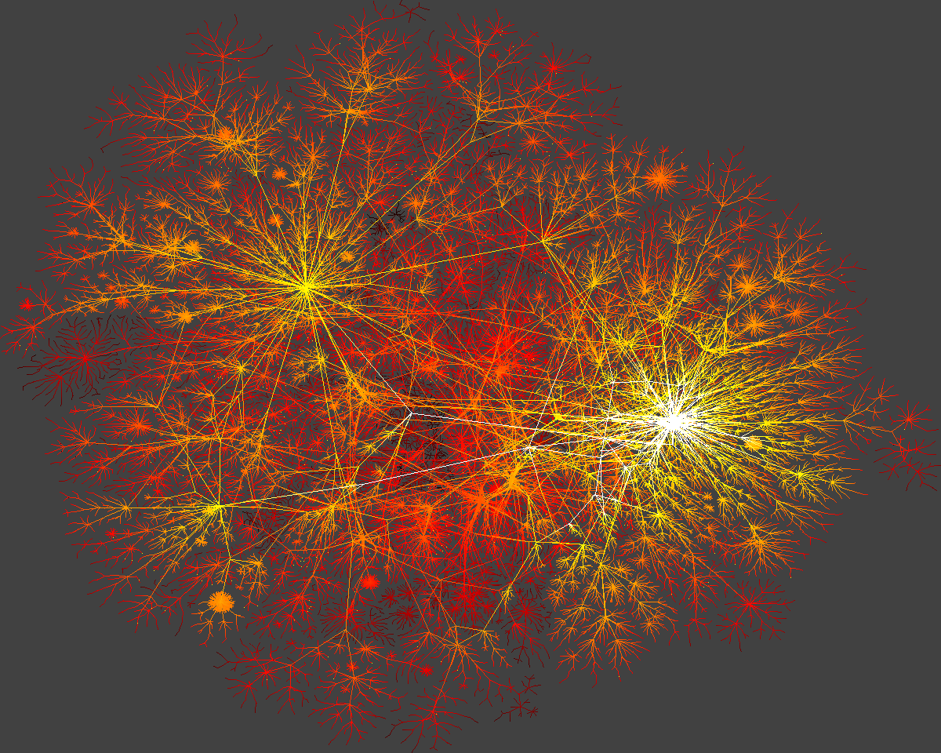
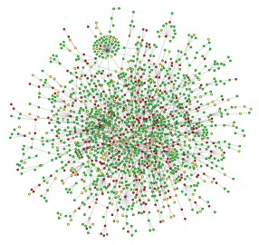
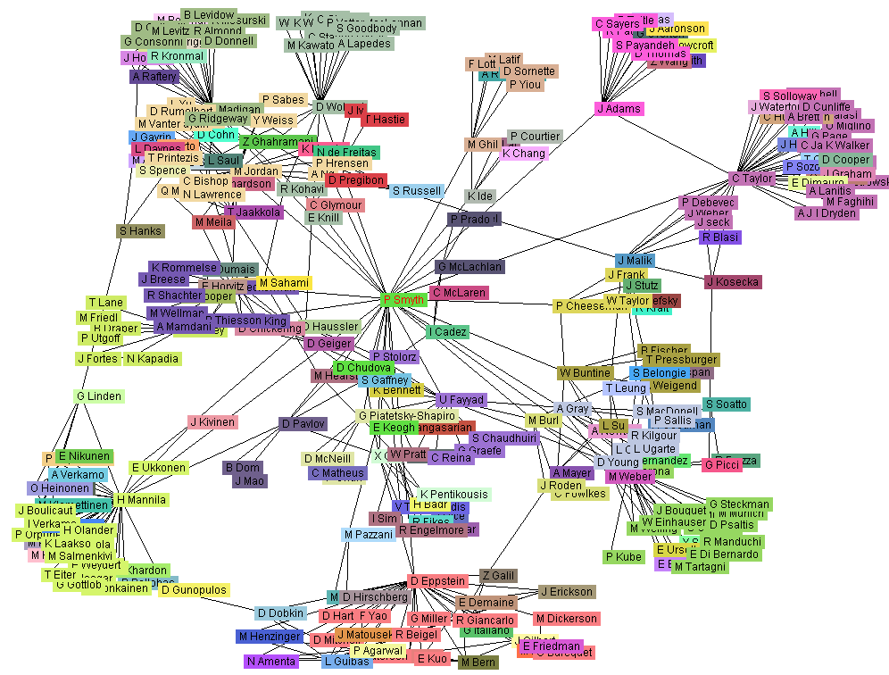
Ubiquitous Information Networks
Graphs and substructures: Chemical compounds, visual objects, circuits, XML
Biological networks
Bibliographic networks: DBLP, ArXiv, PubMed, …
Social networks: Facebook >100 million active users
World Wide Web (WWW): > 3 billion nodes, > 50 billion arcs
Cyber-physical networks
Yeast protein interaction network
World-Wide Web
Co-author network
Social network sites

Slide 5
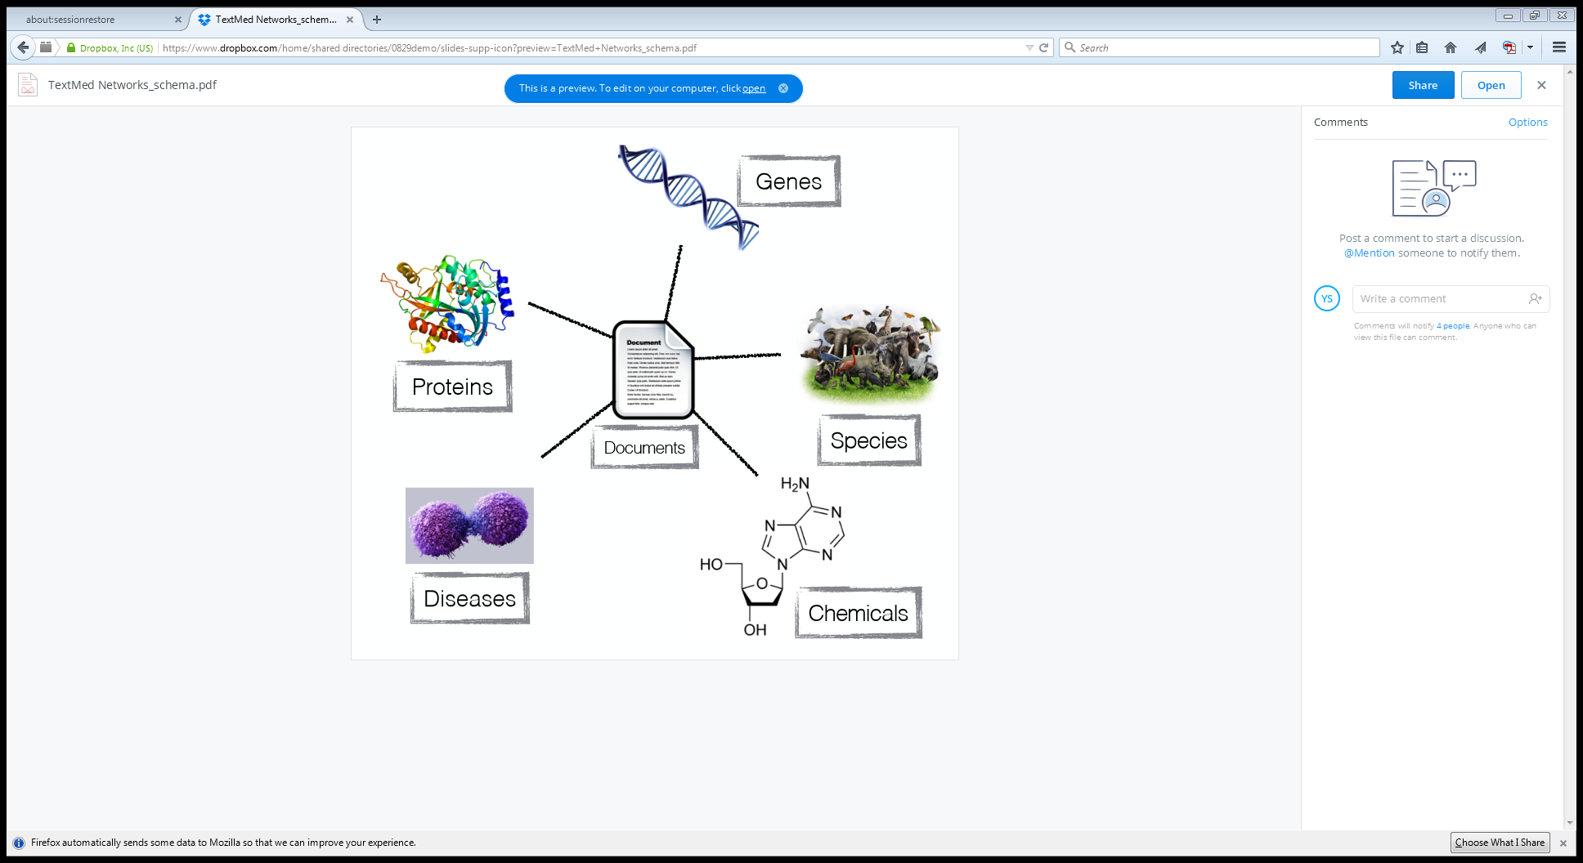
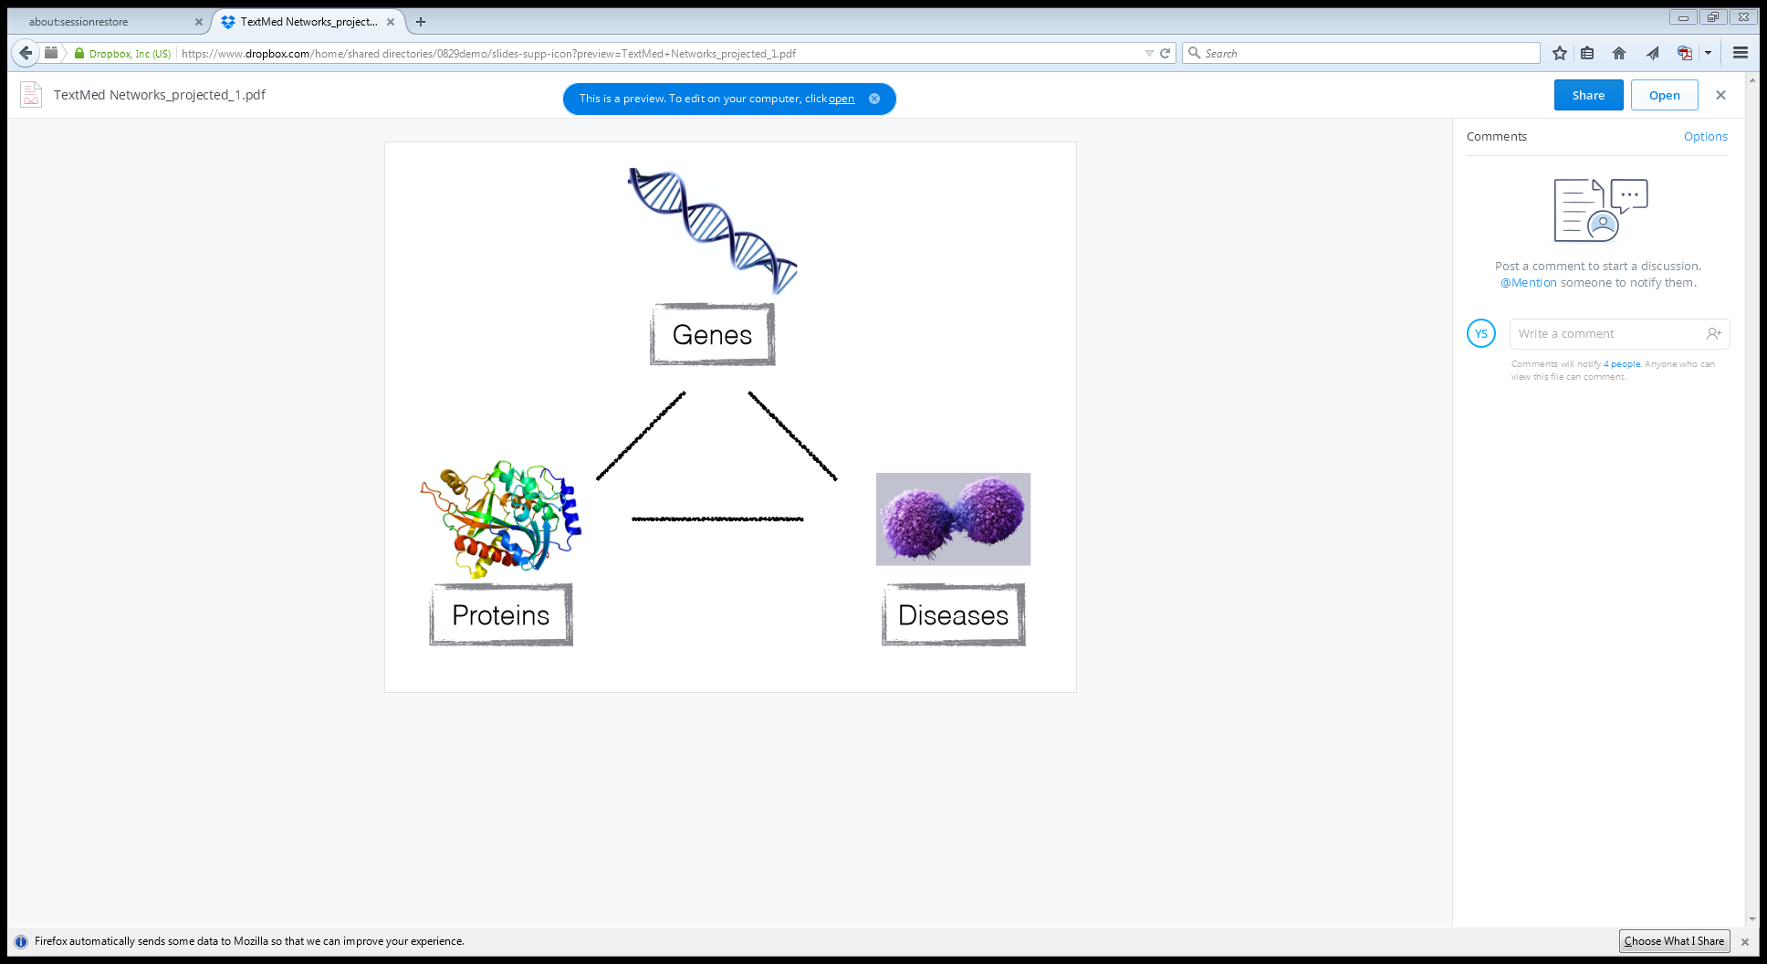
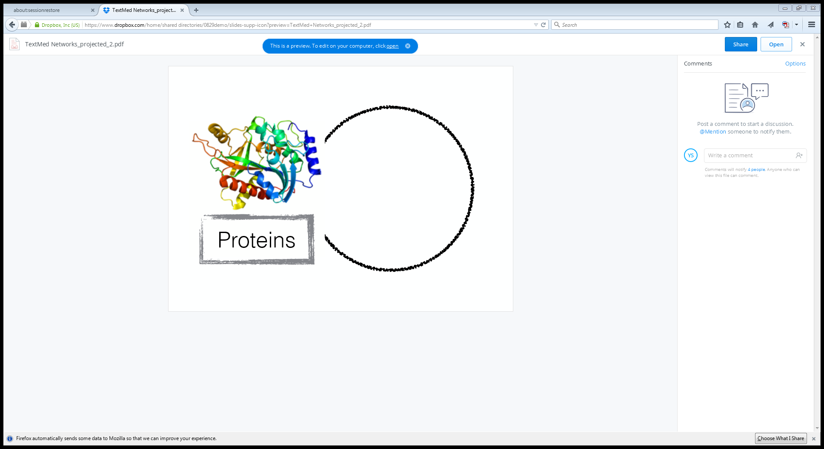
Heterogeneous Information Networks
Homogeneous vs. heterogeneous networks
Homogeneous networks: Single object type and single link type
Single model social networks (e.g., friends)
WWW: A collection of linked Web pages
Heterogeneous networks: Multiple object and link types
Medical network: Patients, doctors, diseases, contacts, treatments
Bibliographic network: Publications, authors, venues (e.g., DBLP > 2 million papers)
Homogeneous networks are often resulted from projection of heterogeneous networks
E.g., coauthor network from its original DBLP network

Slide 6
Homogeneous vs. Heterogeneous Networks
Co-author Network
Conference-Author Network

Slide 7
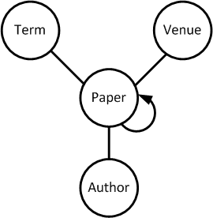
Mining Heterogeneous Information Networks
Homogeneous networks can often be derived from their original heterogeneous networks
Ex. Coauthor networks can be derived from author-paper-conference networks by projection on authors
Paper citation networks can be derived from a complete bibliographic network with papers and citations projected
Heterogeneous networks carry richer information than their corresponding projected homogeneous networks
Typed heterogeneous network vs. non-typed heterogeneous network (i.e., not distinguishing different types of nodes)
Typed nodes and links imply more structures, leading to richer discovery
Mining semi-structured heterogeneous information networks
Clustering, ranking, classification, prediction, similarity search, etc.

Slide 8
Examples of Heterogeneous Information Networks
Bibliographic information networks: DBLP, ArXive, PubMed
Entity types: paper (P), venue (V), author (A), and term (T)
Relation type: authors write papers, venues publish papers, papers contain terms
Twitter information network, and other social media network
Objects types: user, tweet, hashtag, and term
Relation/link types: users follow users, users post tweets, tweets reply tweets, tweets use terms, tweets contain hashtags
Flickr information network
Object types: image, user, tag, group, and comment
Relation types: users upload images, image contain tags, images belong to groups, users post comments, and comments comment on images
Healthcare information network
Object types: doctor, patient, disease, treatment, and device
Relation types: treatments used-for diseases, patients have diseases, patients visit doctors

Slide 9
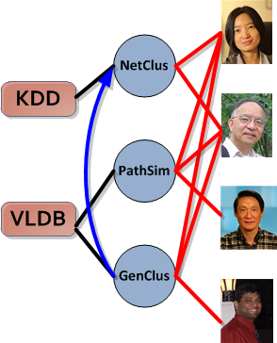
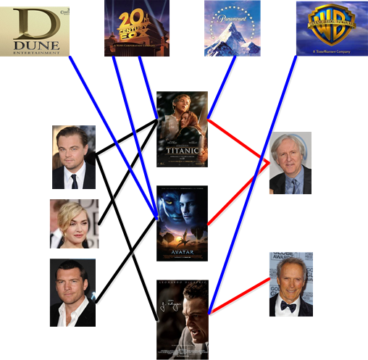
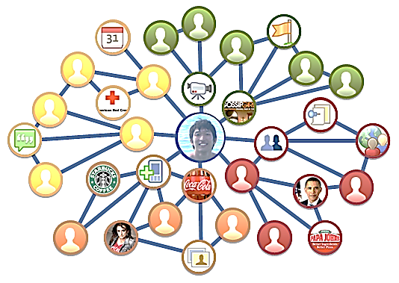
Structures Facilitate Mining Heterogeneous Networks
Network construction: generates structured networks from unstructured text data
Each node: an entity; each link: a relationship between entities
Each node/link may have attributes, labels, and weights
Heterogeneous, multi-typed networks: e.g., Medical network: Patients, doctors, diseases, contacts, treatments
Movie
Studio
Director
The Facebook Network
Venue
Paper
Author
Actor
Movie
It works well for ego-networks!
DBLP Bibliographic Network
The IMDB Movie Network

Slide 10
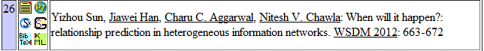
What Can be Mined from Heterogeneous Networks?
A homogeneous network can be derived from its “parent” heterogeneous network
Ex. Coauthor networks from the original author-paper-conference networks
Heterogeneous networks carry richer info. than the projected homogeneous networks
Typed nodes & links imply more structures, leading to richer discovery
Ex.: DBLP: A Computer Science bibliographic database (network)
Knowledge hidden in DBLP Network | Mining Functions
Who are the leading researchers on Web search? | Ranking
Who are the peer researchers of Jure Leskovec? | Similarity Search
Whom will Christos Faloutsos collaborate with? | Relationship Prediction
Which relationships are most influential for an author to decide her topics? | Relation Strength Learning
How was the field of Data Mining emerged or evolving? | Network Evolution
Which authors are rather different from his/her peers in IR? | Outlier/anomaly detection

Slide 11
Principles of Mining Heterogeneous Information Net
Information propagation across heterogeneous nodes & links
How to compute ranking scores, similarity scores, and clusters, and how to make good use of class labels, across heterogeneous nodes and links
Objects in the networks are interdependent and knowledge can only be mined using the holistic information in a network
Search and mining by exploring network meta structures
Heter. info networks: semi-structured and typed
Network schema: a meta structure, guidance of search and mining
Meta-path based similarity search and mining
User-guided exploration of information networks
Automatically select the right relation (or meta-path) combinations with appropriate weights for a particular search or mining task
User-guided or feedback-based network exploration is a strategy

Slide 12

Notes:
Stockholm: where Nobel prize ceremony for science is held

Slide 13
Outline
Motivation: Why Mining Information Networks?
Part I: Clustering and Ranking in Heterogeneous Information Networks
Clustering and Ranking in Information Networks
Similarity Search in Information Networks
User-Guided Meta-Path based Clustering in Heterogeneous Networks
Part II: Classification and Prediction in Heterogeneous Information Networks
Classification of Information Networks
Relationship Prediction in Information Networks
Recommendation with Heterogeneous Information Networks
ClusCite: Citation recommendation in heterogeneous networks
Summary

Slide 14
Ranking-Based Clustering in Heterogeneous Networks
Clustering and ranking: Two critical functions in data mining
Clustering without ranking? Think about no PageRank dark time before Google
Ranking will make more sense within a particular cluster
Einstein in physics vs. Turing in computer science
Why not integrate ranking with clustering & classification?
High-ranked objects should be more important in a cluster than low-ranked ones
Why treat every object the same weight in the same cluster?
But how to get their weight?
Integrate ranking with clustering/classification in the same process
Ranking, as the feature, is conditional (i.e., relative) to a specific cluster
Ranking and clustering may mutually enhance each other
Ranking-based clustering: RankClus [EDBT’09], NetClus [KDD’09]

Slide 15
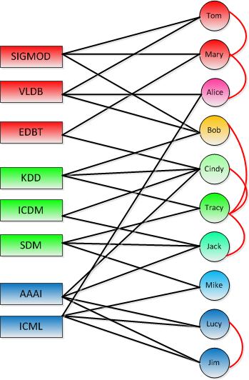
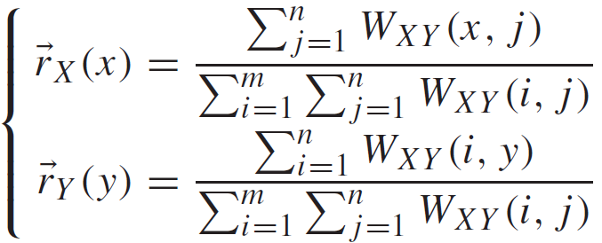
A Bi-Typed Network Model and Simple Ranking
A bi-typed network model
Let X represents type venue
Y: Type author
The DBLP network can be represented as matrix W
Our task: Rank-based clustering of heterogeneous network W
Simple Ranking
Proportional to # of publications of an author and a venue
Considers only immediate neighborhood in the network
A bi-typed network
But what about an author publishing many papers only in very weak venues?

Slide 16
The RankClus Methodology
Ranking as the feature of the cluster
Ranking is conditional on a specific cluster
E.g., VLDB’s rank in Theory vs. its rank in the DB area
The distributions of ranking scores over objects are different in each cluster
Clustering and ranking are mutually enhanced
Better clustering: Rank distributions for clusters are more distinguishing from each other
Better ranking: Better metric for objects is learned from the ranking
Not every object should be treated equally in clustering!
Y. Sun, et al., “RankClus: Integrating Clustering with Ranking for Heterogeneous Information Network Analysis”, EDBT'09

Slide 17
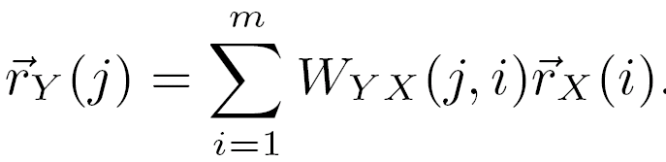
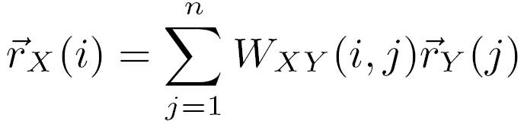
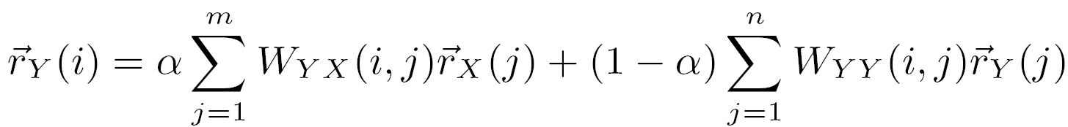
Authority Ranking
Methodology: Propagate the ranking scores in the network over different types
Rule 1: Highly ranked authors publish many papers in highly ranked venues
Rule 2: Highly ranked venues attract many papers from many highly ranked authors
Rule 3: The rank of an author is enhanced if he or she co-authors with many highly ranked authors
Other ranking functions are quite possible (e.g., using domain knowledge)
Ex. Journals may weight more than conferences in science

Slide 18
Alternative Ranking Functions
A ranking function is not only related to the link property, but also depends on domain knowledge
Ex: Journals may weight more than conferences in science
Ranking functions can be defined on multi-typed networks
Ex: PopRank takes into account the impact both from the same type of objects and from the other types of objects, with different impact factors for different types
Use expert knowledge, for example,
TrustRank semi-automatically separates reputable, good objects from spam ones
Personalized PageRank uses expert ranking as query and generates rank distributions w.r.t. such knowledge
A research problem that needs systematic study

Slide 19
The EM (Expectation Maximization) Algorithm
The k-means algorithm has two steps at each iteration (in the E-M framework):
Expectation Step (E-step): Given the current cluster centers, each object is assigned to the cluster whose center is closest to the object: An object is expected to belong to the closest cluster
Maximization Step (M-step): Given the cluster assignment, for each cluster, the algorithm adjusts the center so that the sum of distance from the objects assigned to this cluster and the new center is minimized
The (EM) algorithm: A framework to approach maximum likelihood or maximum a posteriori estimates of parameters in statistical models.
E-step assigns objects to clusters according to the current probabilistic clustering or parameters of probabilistic clusters
M-step finds the new clustering or parameters that minimize the sum of squared error (SSE) or maximize the expected likelihood

Slide 20
From Conditional Rank Distribution to E-M Framework
Given a bi-typed bibliographic network, how can we use the conditional rank scores to further improve the clustering results?
Conditional rank distribution as cluster feature
For each cluster C_{k}, the conditional rank scores, r_{X}|C_{K} and r_{Y}|C_{K}, can be viewed as conditional rank distributions of X and Y, which are the features for cluster C_{k}
Cluster membership as object feature
From p(k|o_{i}) ∝ p(o_{i}|k)p(k), the higher its conditional rank in a cluster (p(o_{i}|k)), the higher possibility an object will belong to that cluster (p(k|o_{i}))
Highly ranked attribute object has more impact on determining the cluster membership of a target object
Parameter estimation using the Expectation-Maximization algorithm
E-step: Calculate the distribution p(z = k|y_{j}, x_{i}, Θ) based on the current value of Θ
M-Step: Update Θ according to the current distribution

Slide 21
RankClus: Integrating Clustering with Ranking
Sub-Network
An EM styled Algorithm
Initialization
Randomly partition
Repeat
Ranking
Ranking objects in each sub-network induced from each cluster
Generating new measure space
Estimate mixture model coefficients for each target object
Adjusting cluster
Until change < threshold
Ranking
Clustering
An E-M framework for iterative enhancement
RankClus [EDBT’09]: Ranking and clustering mutually enhancing each other in an E-M framework

Slide 22
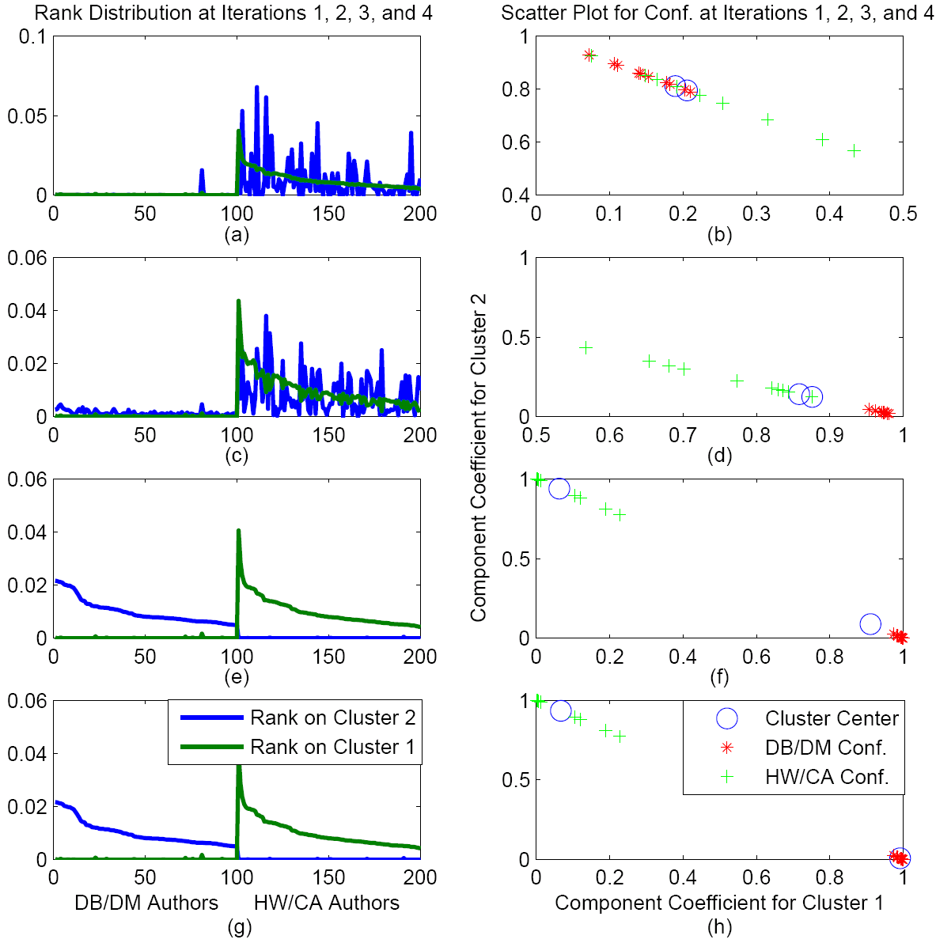
Step-by-Step Running of RankClus
Clustering and ranking of two fields: DB/DM vs. HW/CA (hardware/ computer architecture)
Two clusters of objects mixed together, but preserve similarity somehow
Initially, ranking distributions are mixed together
Two clusters are almost well separated
Improved a little
Improved significantly
Well separated
Stable
Stable

Slide 23
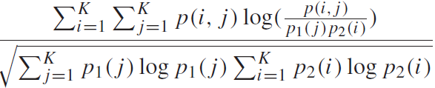
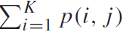
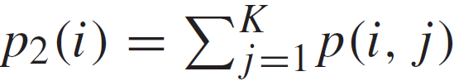
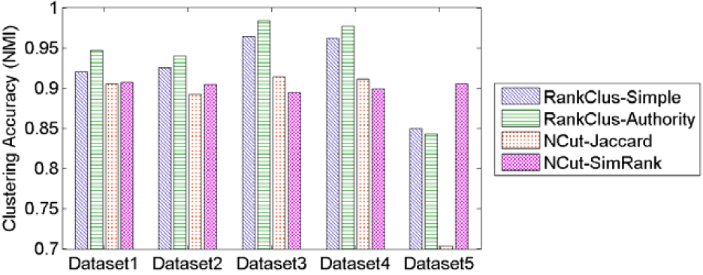
Clustering Performance (NMI)
Compare the clustering accuracy: For N objects, K clusters, and two clustering results, let n(i, j ), be # objects with cluster label i in the 1st clustering result (say generated by the new alg.) and that w. cluster label j in the 2nd clustering result (say the ground truth)
Normalized Mutual Info. (NMI):
joint distribution: p(i, j) = n(i,j )/N
row distr. p₁(j) = , column distr.
D1: med. separated & med. density
D2: med. separated & low density
D3: med. Separated & high density
D4: highly separated & med. density
D5: poorly separated & med. density

Slide 24
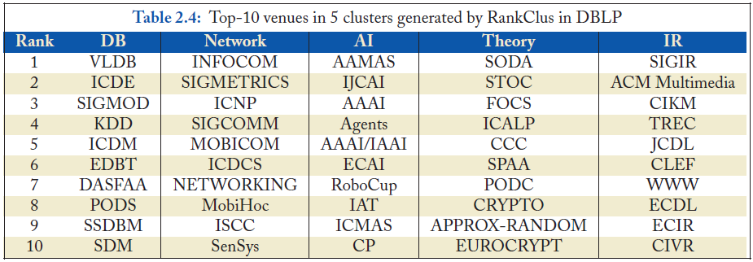
RankClus: Clustering & Ranking CS Venues in DBLP
Top-10 conferences in 5 clusters using RankClus in DBLP (when k = 15)

Slide 25
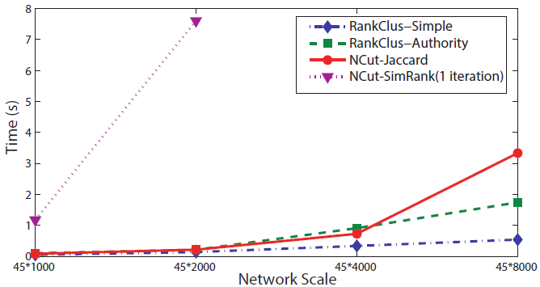
Time Complexity: Linear to # of Links
At each iteration, |E|: edges in network, m: # of target objects, K: # of clusters
Ranking for sparse network
~O(|E|)
Mixture model estimation
~O(K|E|+mK)
Cluster adjustment
~O(mK^2)
In all, linear to |E|
~O(K|E|)
Note: SimRank will be at least quadratic at each iteration since it evaluates distance between every pair in the network
Comparison of algorithms on execution time

Slide 26
NetClus: Ranking-Based Clustering with Star Network Schema
Beyond bi-typed network: Capture more semantics with multiple types
Split a network into multi-subnetworks, each a (multi-typed) net-cluster [KDD’09]
DBLP network: Using terms, venues, and authors to jointly distinguish a sub-field, e.g., database

Slide 27
The NetClus Algorithm
Generate initial partitions for target objects and induce initial net-clusters from the original network
Repeat // An E-M Framework
Build ranking-based probabilistic generative model for each net-cluster
Calculate the posterior probabilities for each target object
Adjust their cluster assignment according to the new measure defined by the posterior probabilities to each cluster
Until the clusters do not change significantly
Calculate the posterior probabilities for each attribute object in each net-cluster

Slide 28
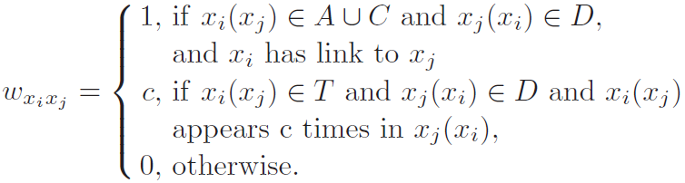
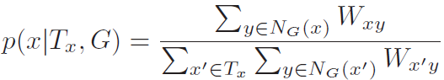
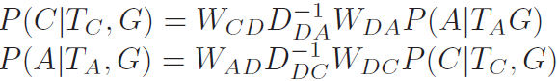
NetClus on the DBLP Network
NetClus initialization: G = (V, E, W), weight w_{xixj} linking x_{i} and x_{j}
V = A U C U D U T, where D (paper), A (author), C (conf.), T(term)
Simple ranking:
Authority ranking for type Y based on type X, through the center type Z:
For DBLP:

Slide 29
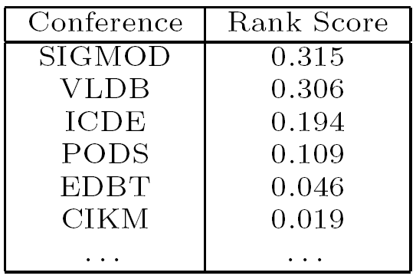
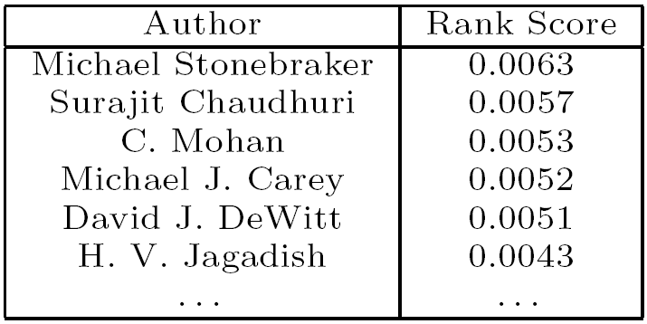
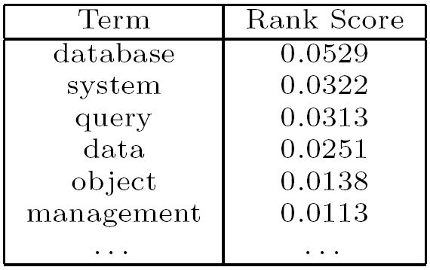
Multi-Typed Networks Lead to Better Results
The network cluster for database area: Conferences, Authors, and Terms
NetClus leads to better clustering and ranking than RankClus
NetClus vs. RankClus: 16% higher accuracy on conference clustering

Slide 30
NetClus: Distinguishing Conferences
AAAI 0.0022667 0.00899168 0.934024 0.0300042 0.0247133
CIKM 0.150053 0.310172 0.00723807 0.444524 0.0880127
CVPR 0.000163812 0.00763072 0.931496 0.0281342 0.032575
ECIR 3.47023e-05 0.00712695 0.00657402 0.978391 0.00787288
ECML 0.00077477 0.110922 0.814362 0.0579426 0.015999
EDBT 0.573362 0.316033 0.00101442 0.0245591 0.0850319
ICDE 0.529522 0.376542 0.00239152 0.0151113 0.0764334
ICDM 0.000455028 0.778452 0.0566457 0.113184 0.0512633
ICML 0.000309624 0.050078 0.878757 0.0622335 0.00862134
IJCAI 0.00329816 0.0046758 0.94288 0.0303745 0.0187718
KDD 0.00574223 0.797633 0.0617351 0.067681 0.0672086
PAKDD 0.00111246 0.813473 0.0403105 0.0574755 0.0876289
PKDD 5.39434e-05 0.760374 0.119608 0.052926 0.0670379
PODS 0.78935 0.113751 0.013939 0.00277417 0.0801858
SDM 0.000172953 0.841087 0.058316 0.0527081 0.0477156
SIGIR 0.00600399 0.00280013 0.00275237 0.977783 0.0106604
SIGMOD 0.689348 0.223122 0.0017703 0.00825455 0.0775055
VLDB 0.701899 0.207428 0.00100012 0.0116966 0.0779764
WSDM 0.00751654 0.269259 0.0260291 0.683646 0.0135497
WWW 0.0771186 0.270635 0.029307 0.451857 0.171082

Slide 31
NetClus: Experiment on DBLP: Database System Cluster
Term
Venue
Author
database 0.0995511
databases 0.0708818
system 0.0678563
data 0.0214893
query 0.0133316
systems 0.0110413
queries 0.0090603
management 0.00850744
object 0.00837766
relational 0.0081175
processing 0.00745875
based 0.00736599
distributed 0.0068367
xml 0.00664958
oriented 0.00589557
design 0.00527672
web 0.00509167
information 0.0050518
model 0.00499396
efficient 0.00465707
VLDB 0.318495
SIGMOD Conf. 0.313903
ICDE 0.188746
PODS 0.107943
EDBT 0.0436849
Surajit Chaudhuri 0.00678065
Michael Stonebraker 0.00616469
Michael J. Carey 0.00545769
C. Mohan 0.00528346
David J. DeWitt 0.00491615
Hector Garcia-Molina 0.00453497
H. V. Jagadish 0.00434289
David B. Lomet 0.00397865
Raghu Ramakrishnan 0.0039278
Philip A. Bernstein 0.00376314
Joseph M. Hellerstein 0.00372064
Jeffrey F. Naughton 0.00363698
Yannis E. Ioannidis 0.00359853
Jennifer Widom 0.00351929
Per-Ake Larson 0.00334911
Rakesh Agrawal 0.00328274
Dan Suciu 0.00309047
Michael J. Franklin 0.00304099
Umeshwar Dayal 0.00290143
Abraham Silberschatz 0.00278185
NetClus generates high quality clusters for all of the three participating types in the DBLP network
Quality can be easily judged by our commonsense knowledge
Highly-ranked objects: Objects centered in the cluster

Slide 32
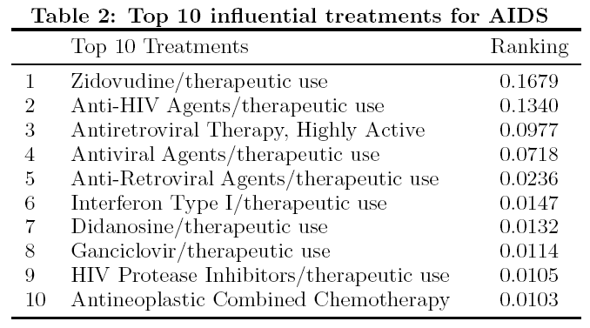
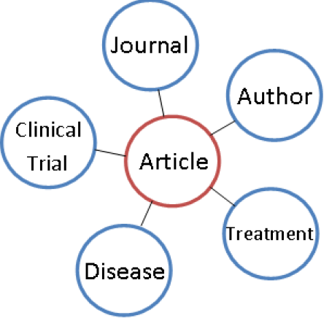
Rank-Based Clustering: Works in Multiple Domains
RankCompete: Organize your photo album automatically!
Use multi-typed image features to build up heterogeneous networks
Explore multiple types in a star schema network
MedRank: Rank treatments for AIDS from Medline

Slide 33
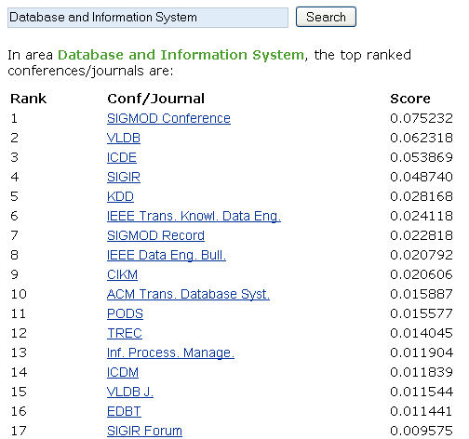
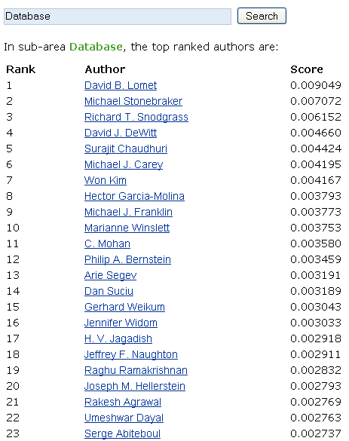
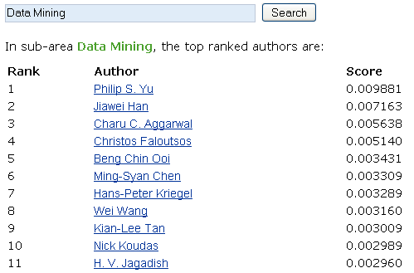
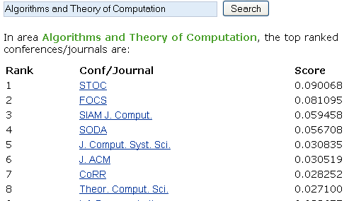
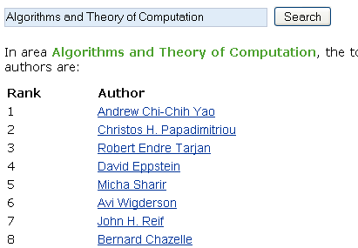
iNextCube: Information Network-Enhanced Text Cube (VLDB’09 Demo)
Demo: iNextCube.cs.uiuc.edu
Dimension hierarchies generated by NetClus
Author/conference/ term ranking for each research area. The research areas can be at different levels.
Architecture of iNextCube
All
DB and IS
Theory
Architecture …
DB
DM
IR
XML
Distributed DB …
Net-cluster Hierarchy

Slide 34
Impact of RankClus Methodology
RankCompete [Cao et al., WWW’10]
Extend to the domain of web images
RankClus in Medical Literature [Li et al., Working paper]
Ranking treatments for diseases
RankClass [Ji et al., KDD’11]
Integrate classification with ranking
Trustworthy Analysis [Gupta et al., WWW’11] [Khac Le et al., IPSN’11]
Integrate clustering with trustworthiness score
Topic Modeling in Heterogeneous Networks [Deng et al., KDD’11]
Propagate topic information among different types of objects
…

Slide 35


Slide 36
Outline
Motivation: Why Mining Information Networks?
Part I: Clustering and Ranking in Heterogeneous Information Networks
Clustering and Ranking in Information Networks
Similarity Search in Information Networks
User-Guided Meta-Path based Clustering in Heterogeneous Networks
Part II: Classification and Prediction in Heterogeneous Information Networks
Classification of Information Networks
Relationship Prediction in Information Networks
Recommendation with Heterogeneous Information Networks
ClusCite: Citation recommendation in heterogeneous networks
Summary

Slide 37

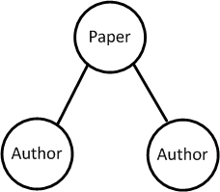
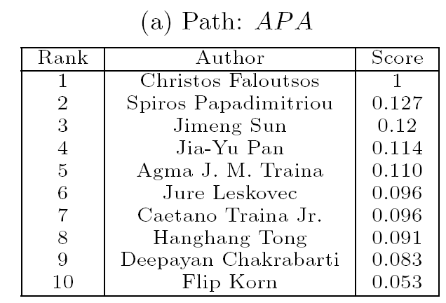
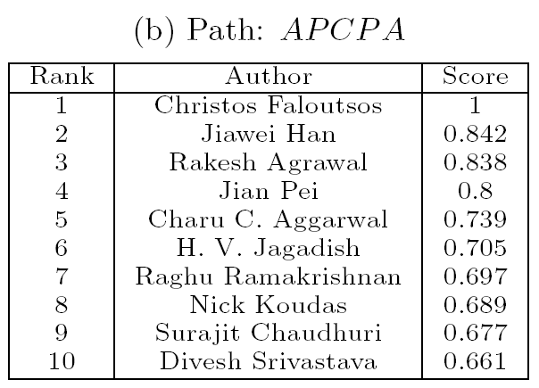
Similarity Search in Heterogeneous Networks
Similarity measure/search is the base for cluster analysis
Who are the most similar to Christos Faloutsos based on the DBLP network?
Meta-Path: Meta-level description of a path between two objects
A path on network schema
Denote an existing or concatenated relation between two object types
Different meta-paths tell different semantics
Meta-Path: Author-Paper-Author
Meta-Path: Author-Paper-Venue-Paper-Author
Co-authorship Meta-path: A-P-A
Christos’ students or close collaborators
Work in similar fields with similar reputation

Slide 38
Existing Popular Similarity Measures for Networks
Random walk (RW):
The probability of random walk starting at x and ending at y, with meta-path P
Used in Personalized PageRank (P-Pagerank) (Jeh and Widom 2003)
Favors highly visible objects (i.e., objects with large degrees)
Pairwise random walk (PRW):
The probability of pairwise random walk starting at (x, y) and ending at a common object (say z), following a meta-path (P₁, P₂)
Used in SimRank (Jeh and Widom 2002)
Favors pure objects (i.e., objects with highly skewed distribution in their in-links or out-links)
X
Y
P
Note: P-PageRank and SimRank do not distinguish object type and relationship type
X
Y
P₂⁻¹
P₁
Z

Slide 39
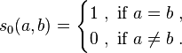
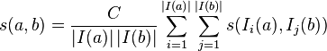
SimRank and Personalized PageRank
SimRank (Jeh and Widom 2002)
Base: objects are maximally similar to themselves, i.e.,
Induction: Two objects are considered to be similar if they are referenced by similar objects
The computation is quite costly: Many efficient computation methods proposed
Personalized PageRank (P-Pagerank) (Jeh and Widom 2003)
P-PageRank score x is defined as: x = αPx + (1 − α)b, where P is a transition matrix of the network G, b is a stochastic vector, called personalized vector, and α ∈ (0, 1) is the teleportation constant
Efficient computation methods are also studied (e.g., Maehara, et al., VLDB’14)
Glen Jeh and Jennifer Widom. SimRank: A Measure of Structural-Context Similarity. In KDD'02
Glen Jeh and Jennifer Widom. Scaling Personalized Web Search, In WWW 2003

Slide 40
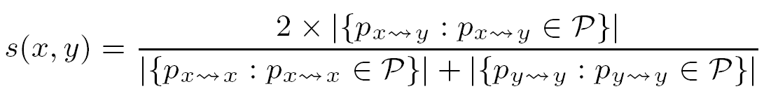
Which Similarity Measure Is Better for Finding Peers?
PathSim: Favors peers
Peers: Objects with strong connectivity and similar visibility with a given meta-path
Who is more similar to Mike?
Author\Conf. | SIGMOD | VLDB | ICDM | KDD
Mike | 2 | 1 | 0 | 0
Jim | 50 | 20 | 0 | 0
Mary | 2 | 0 | 1 | 0
Bob | 2 | 1 | 0 | 0
Ann | 0 | 0 | 1 | 1
x
y
Measure\Author | Jim | Mary | Bob | Ann
P-PageRank | 0.376 | 0.013 | 0.016 | 0.005
SimRank | 0.716 | 0.572 | 0.713 | 0.184
Random Walk | 0.8983 | 0.0238 | 0.0390 | 0
Pairwise R.W. | 0.5714 | 0.4440 | 0.5556 | 0
PathSim (APCPA) | 0.083 | 0.8 | 1 | 0
Meta-path: APCPA
Mike publishes similar # of papers as Bob and Mary
Other measures find Mike is closer to Jim
Comparison of Multiple Measures: A Toy Example

Slide 41


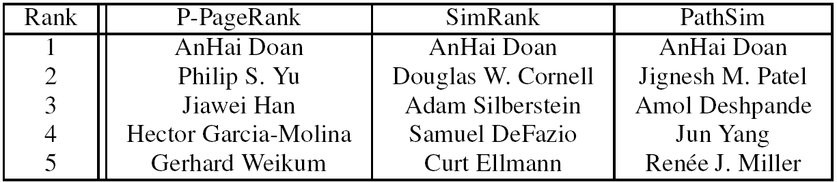


Example with DBLP: Find Academic Peers by PathSim
Anhai Doan
CS, Wisconsin
Database area
PhD: 2002
Jignesh Patel
CS, Wisconsin
Database area
PhD: 1998
Meta-Path: Author-Paper-Venue-Paper-Author
Amol Deshpande
CS, Maryland
Database area
PhD: 2004
Jun Yang
CS, Duke
Database area
PhD: 2001

Slide 42


Some Meta-Path Is “Better” Than Others
Which pictures are most similar to this one?
Image
Group
User
Tag
Evaluate the similarity between images according to their linked tags
Evaluate the similarity between images according to tags and groups
Meta-Path: Image-Tag-Image
Meta-Path: Image-Tag-Image-Group-Image-Tag-Image

Slide 43
Comparing Similarity Measures in DBLP Data
Which venues are most similar to DASFAA?
Favor highly visible objects
Which venues are most similar to SIGMOD?
Are these tiny forums most similar to SIGMOD?

Slide 44
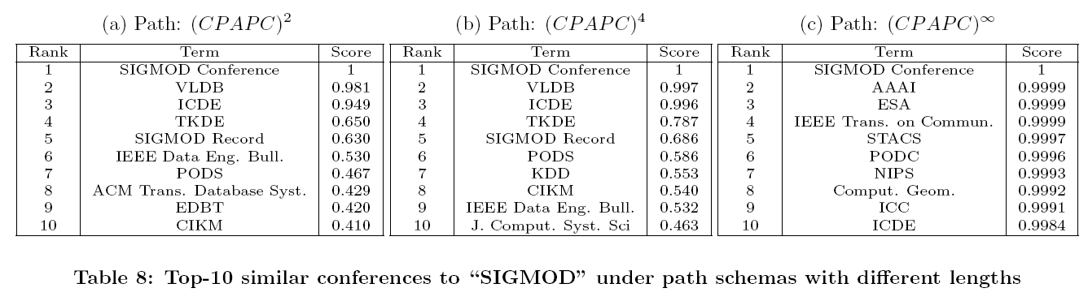
Long Meta-Path May Not Carry the Right Semantics
Repeat the meta-path 2, 4, and infinite times for conference similarity query

Slide 45
Co-Clustering-Based Pruning Algorithm
Meta-Path based similarity computation can be costly
The overall cost can be reduced by storing commuting matrices for short path schemas and computing top-k queries on line
Framework
Generate co-clusters for materialized commuting
matrices for feature objects and target objects
Derive upper bound for similarity between object and
target cluster and between object and object
Safely prune target clusters and objects if the upper bound similarity is lower than current threshold
Dynamically update top-k threshold

Slide 46
Meta-Path: A Key Concept for Heterogeneous Networks
Meta-path based mining
PathPredict [Sun et al., ASONAM’11]
Co-authorship prediction using meta-path based similarity
PathPredict_when [Sun et al., WSDM’12]
When a relationship will happen
Citation prediction [Yu et al., SDM’12]
Meta-path + topic
Meta-path learning
User Guided Meta-Path Selection [Sun et al., KDD’12]
Meta-path selection + clustering

Slide 47


Slide 48
Outline
Motivation: Why Mining Information Networks?
Part I: Clustering and Ranking in Heterogeneous Information Networks
Clustering and Ranking in Information Networks
Similarity Search in Information Networks
User-Guided Meta-Path based Clustering in Heterogeneous Networks
Part II: Classification and Prediction in Heterogeneous Information Networks
Classification of Information Networks
Relationship Prediction in Information Networks
Recommendation with Heterogeneous Information Networks
ClusCite: Citation recommendation in heterogeneous networks
Summary

Slide 49
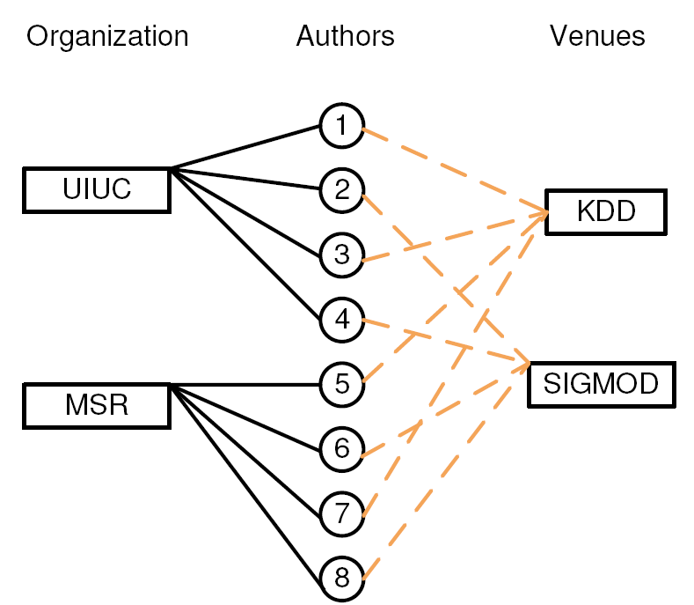
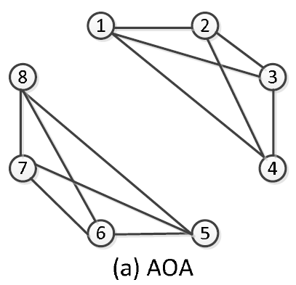
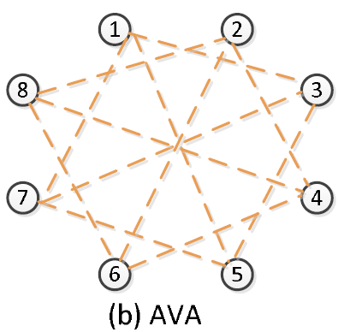
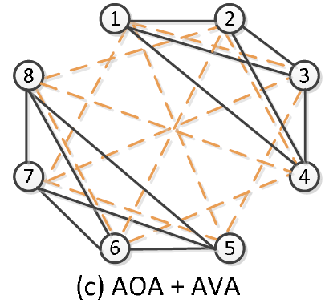
Why User Guidance in Clustering?
Different users may like to get different clusters for different clustering goals
Ex. Clustering authors based on their connections in the network
Which meta-path(s) to choose?
{1,2,3,4}
{5,6,7,8}
{1,3} {2,4} {5,7} {6,8}
{1,3,5,7}
{2,4,6,8}

Slide 50
User Guidance Determines Clustering Results
Different user preferences (e.g., by seeding desired clusters) lead to the choice of different meta-paths
Problem: User-guided clustering with meta-path selection
Input:
The target type for clustering T
# of clusters k
Seeds in some clusters: L₁, …, L_{k}
Candidate meta-paths: P₁, …, P_{M}
Output:
Weight of each meta-path: w₁, …, w_{m}
Clustering results that are consistent with the user guidance
{1}
{5}
{1,2,3,4}
{5,6,7,8}
+
Seeds
Meta-path(s)
Clustering
{1} {2} {5} {6}
{1,3} {2,4} {5,7} {6,8}
+
Seeds
Meta-path(s)
Clustering

Slide 51
PathSelClus: A Probabilistic Modeling Approach
Part 1: Modeling the Relationship Generation
A good clustering result should lead to high likelihood in observing existing relationships
Higher quality relations should count more in the total likelihood
Part 2: Modeling the Guidance from Users
The more consistent with the guidance, the higher probability of the clustering result
Part 3: Modeling the Quality Weights for Meta-Paths
The more consistent with the clustering result, the higher quality weight

Slide 52
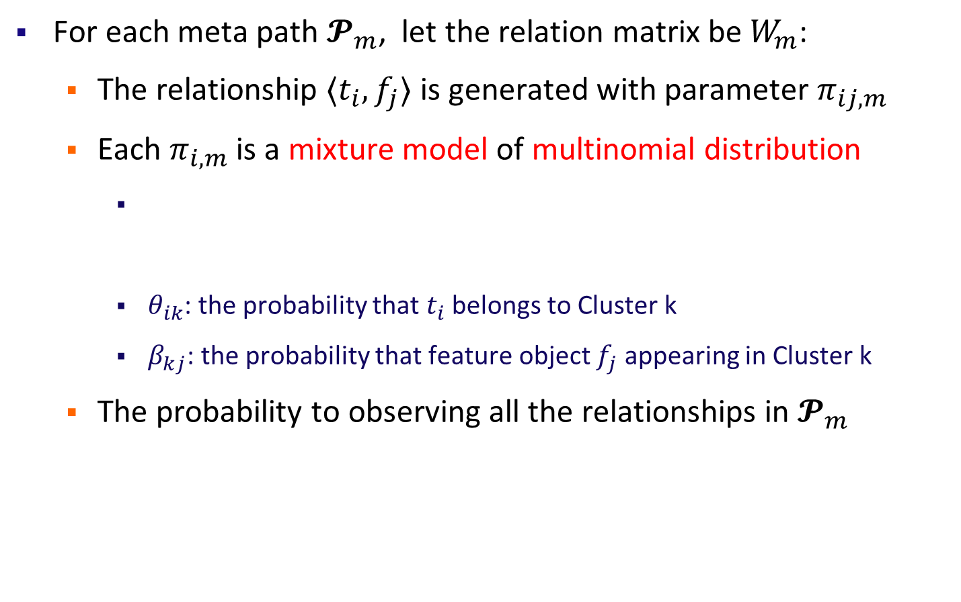


Part 1: Modeling the Relationship Generation

Slide 53


Part 2: Modeling the Guidance from Users

Slide 54


Part 3: Modeling the Quality Weights for Meta-Paths
Dirichlet Distribution

Slide 55


The Learning Algorithm

Slide 56


Effectiveness of Meta-Path Selection
Experiments on Yelp data
Object Types: Users, Businesses, Reviews, Terms
Relation Types: UR, RU, BR, RB, TR, RT
Task: Candidate meta-paths: B-R-U-R-B, B-R-T-R-B
Target objects: restaurants
# of clusters: 6
Output:
PathSelClus vs. others
High accuracy
Restaurant vs. shopping
Users try different kinds of food
For restraunts, meta-path B-R-U-R-B weighs only 0.1716
For clustering shopping, B-R-U-R-B weighs 0.5864

Slide 57


Slide 58
Outline
Motivation: Why Mining Information Networks?
Part I: Clustering and Ranking in Heterogeneous Information Networks
Clustering and Ranking in Information Networks
Similarity Search in Information Networks
User-Guided Meta-Path based Clustering in Heterogeneous Networks
Part II: Classification and Prediction in Heterogeneous Information Networks
Classification of Heterogeneous Information Networks
Relationship Prediction in Heterogeneous Information Networks
Recommendation with Heterogeneous Information Networks
ClusCite: Citation Recommendation in Heterogeneous Information Networks
Summary

Slide 59

Classification: Knowledge Propagation Across Heterogeneous Typed Networks
RankClass [Ji et al., KDD’11]: Ranking-based classification
Highly ranked objects will play more role in classification
Class membership and ranking are statistical distributions
Let ranking and classification mutually enhance each other!
Output: Classification results + ranking list of objects within each class
Classification: Labeled knowledge propagates through multi-typed objects across heterogeneous networks [KDD’11]

Slide 60
GNetMine: Methodology
Classification of networked data can be essentially viewed as a process of knowledge propagation, where information is propagated from labeled objects to unlabeled ones through links until a stationary state is achieved
A novel graph-based regularization framework to address the classification problem on heterogeneous information networks
Respect the link type differences by preserving consistency over each relation graph corresponding to each type of links separately
Mathematical intuition: Consistency assumption
The confidence (f)of two objects (x_{ip} and x_{jq}) belonging to class k should be similar if x_{ip} ↔ x_{jq} (R_{ij,pq} > 0)
f should be similar to the given ground truth on the labeled data

Slide 61
GNetMine: Graph-Based Regularization
Minimize the objective function
User preference: how much do you value this relationship / ground truth?
Smoothness constraints: objects linked together should share similar estimations of confidence belonging to class k
Normalization term applied to each type of link separately: reduce the impact of popularity of objects
Confidence estimation on labeled data and their pre-given labels should be similar

Slide 62
RankClass: Ranking-Based Classification
Classification in heterogeneous networks
Knowledge propagation: Class label knowledge propagated across multi-typed objects through a heterogeneous network
GNetMine [Ji et al., PKDD’10]: Objects are treated equally
RankClass [Ji et al., KDD’11]: Ranking-based classification
Highly ranked objects will play more role in classification
An object can only be ranked high in some focused classes
Class membership and ranking are stat. distributions
Let ranking and classification mutually enhance each other!
Output: Classification results + ranking list of objects within each class

Slide 63
From RankClus to GNetMine & RankClass
RankClus [EDBT’09]: Clustering and ranking working together
No training, no available class labels, no expert knowledge
GNetMine [PKDD’10]: Incorp. label information in networks
Classification in heterog. networks, but objects treated equally
RankClass [KDD’11]: Integration of ranking and classification in heterogeneous network analysis
Ranking: informative understanding & summary of each class
Class membership is critical information when ranking objects
Let ranking and classification mutually enhance each other!
Output: Classification results + ranking list of objects within each class

Slide 64




Why Rank-Based Classification?
Different objects within one class have different importance/visibility!
The ranking of objects within one class serves as an informative understanding and summary of the class
6
7
9
10
8
11

Slide 65
Motivation
Why not do ranking after classification, or vice versa?
Because they mutually enhance each other, not unidirectional.
RankClass: iteratively let ranking and classification mutually enhance each other
Ranking
Classification

Slide 66











RankClass: Ranking-Based Classification
Class: a group of multi-typed nodes sharing the same topic + within-class ranking
node
class
The RankClass Framework
Converge

Slide 67
Graph-Based Ranking
Intuitive idea: authority propagation
Objects linked together are likely to share similar ranking scores within class k
Update the ranking score of each object by looking t the ranking of its neighbors
The initial ranking score
Notes:
Note that we use the normalized relation matrices instead of the original ones: 𝑆_𝑖𝑗=𝐷_𝑖𝑗^((−1/2)) 𝑅_𝑖𝑗 𝐷_𝑗𝑖^((−1/2)), 𝐷_𝑖𝑗=𝑑𝑖𝑎𝑔[∑2_𝑞▒𝑅_(𝑖𝑗, 𝑝𝑞) ] This not only generates more stable results, but also supports the later steps since multiplying 𝑅_𝑖𝑗 by any constant will not change 𝑆_𝑖𝑗

Slide 68
Partition the Network Softly
Ideally, the within-class ranking should be performed within the sub-network corresponding to each class
Use the ranking distribution to describe each class
Gradually emphasize the network on highly ranked objects, and weaken the network on lowly ranked objects
Sub-network for class 1
Sub-network for class 2
Sub-network for class 3
Original network

Slide 69



Comparing Classification Accuracy on the DBLP Data
Class: Four research areas: DB, DM, AI, IR
Four types of objects
Paper(14376), Conf.(20), Author(14475), Term(8920)
Three types of relations
Paper-conf., paper-author, paper-term
Algorithms for comparison
LLGC [Zhou et al. NIPS’03]
wvRN) [Macskassy et al. JMLR’07]
nLB [Lu et al. ICML’03, Macskassy et al. JMLR’07]

Slide 70
Object Ranking in Each Class: Experiment
DBLP: 4-fields data set (DB, DM, AI, IR) forming a heterog. info. Network
Rank objects within each class (with extremely limited label information)
Obtain high classification accuracy and excellent ranking within each class
 | Database | Data Mining | AI | IR
Top-5 ranked conferences | VLDB | KDD | IJCAI | SIGIR
 | SIGMOD | SDM | AAAI | ECIR
 | ICDE | ICDM | ICML | CIKM
 | PODS | PKDD | CVPR | WWW
 | EDBT | PAKDD | ECML | WSDM
Top-5 ranked terms | data | mining | learning | retrieval
 | database | data | knowledge | information
 | query | clustering | reasoning | web
 | system | classification | logic | search
 | xml | frequent | cognition | text

Slide 71


Slide 72
Outline
Motivation: Why Mining Information Networks?
Part I: Clustering and Ranking in Heterogeneous Information Networks
Clustering and Ranking in Information Networks
Similarity Search in Information Networks
User-Guided Meta-Path based Clustering in Heterogeneous Networks
Part II: Classification and Prediction in Heterogeneous Information Networks
Classification of Heterogeneous Information Networks
Relationship Prediction in Heterogeneous Information Networks
Recommendation with Heterogeneous Information Networks
ClusCite: Citation Recommendation in Heterogeneous Information Networks
Summary

Slide 73



Relationship Prediction vs. Link Prediction
Link prediction in homogeneous networks [Liben-Nowell and Kleinberg, 2003, Hasan et al., 2006]
E.g., friendship prediction
Relationship prediction in heterogeneous networks
Different types of relationships need different prediction models
Different connection paths need to be treated separately!
Meta-path-based approach to define topological features
vs.
vs.

Slide 74
Why Prediction Using Heterogeneous Info Networks?
Rich semantics contained in structured, text-rich heterogeneous networks
Homogeneous networks, such as coauthor networks, miss too much criticially important information
Schema-guided relationship prediction
Semantic relationships among similar typed links share similar semantics and are comparable and inferable
Relationships across different typed links are not directly comparable but their collective behavior will help predict particular relationships
Meta-paths: encoding topological features
E.g., citation relations between authors: A — P → P — A
Y. Sun, R. Barber, M. Gupta, C. Aggarwal and J. Han, "Co-Author Relationship Prediction in Heterogeneous Bibliographic Networks", ASONAM'11
write
cite
write

Slide 75

PathPredict: Meta-Path Based Relationship Prediction
vs.
Who will be your new coauthors in the next 5 years?
Meta path-guided prediction of links and relationships
Philosophy: Meta path relationships among similar typed links share similar semantics and are comparable and inferable
Co-author prediction (A—P—A) [Sun et al., ASONAM’11]
Use topological features encoded by meta paths, e.g., citation relations between authors (A—P→P—A)
Meta-Path
Semantic Meaning
Meta-paths between authors of length ≤ 4

Slide 76


Logistic Regression-Based Prediction Model
Training and test pair: <x_{i}, y_{i}> = <history feature list, future relationship label>
Logistic Regression Model
Model the probability for each relationship as
$β$ is the coefficients for each feature (including a constant 1)
MLE (Maximum Likelihood Estimation)
Maximize the likelihood of observing all the relationships in the training data
 | A—P—A—P—A | A—P—V—P—A | A—P—T—P—A | A—P→P—A | A—P—A
<Mike, Ann> | 4 | 5 | 100 | 3 | Yes = 1
<Mike, Jim> | 0 | 1 | 20 | 2 | No = 0
Notes:
Examples: pos/neg example

Slide 77


Selection among Competitive Measures
We study four measures that defines a relationship R encoded by a meta path
Path Count: Number of path instances between authors following R
Normalized Path Count: Normalize path count following R by the “degree” of authors
Random Walk: Consider one way random walk following R
Symmetric Random Walk: Consider random walk in both directions

Slide 78
Performance Comparison: Homogeneous vs. Heterogeneous Topological Features
Homogeneous features
Only consider co-author sub-network (common neighbor; rooted PageRank)
Mix all types together (homogeneous path count)
Heterogeneous feature
Heterogeneous path count
Notation: HP2hop: highly productive source authors with 2-hops reaching target authors

Slide 79
Comparison among Different Topological Features
Hybrid heterogeneous topological feature is the best
Notations
(1) the path count (PC)
the normalized path count (NPC)
(3) the random walk (RW)
(4) the symmetric random walk (SRW)
PC1: homogeneous common neighbor
PCSum: homogeneous path count

Slide 80


The Power of PathPredict: Experiment on DBLP
Explain the prediction power of each meta-path
Wald Test for logistic regression
Higher prediction accuracy than using projected homogeneous network
11% higher in prediction accuracy
Social relations play more important role?
Evaluation of the prediction power of different meta-paths
Prediction of new coauthors of Jian Pei in [2003-2009]
Co-author prediction for Jian Pei: Only 42 among 4809 candidates are true first-time co-authors!
(Feature collected in [1996, 2002]; Test period in [2003,2009])

Slide 81



When Will It Happen?
From “whether” to “when”
“Whether”: Will Jim rent the movie “Avatar” in Netflix?
“When”: When will Jim rent the movie “Avatar”?
What is the probability Jim will rent “Avatar” within 2 months? $P(Y≤2)$
By when Jim will rent “Avatar” with 90% probability? $t:P\left(Y≤t\right)=0.9$
What is the expected time it will take for Jim to rent “Avatar”? $E(Y)$
Output: P(X=1)=?
Output: A distribution of time!
May provide useful information to supply chain management
Notes:
Supply chain

Slide 82



The Relationship Building Time Prediction Model
Solution
Directly model relationship building time: P(Y=t)
Geometric distribution, Exponential distribution, Weibull distribution
Use generalized linear model
Deal with censoring (relationship builds beyond the observed time interval)
T: Right
Censoring
Generalized Linear Model
under Weibull Distribution Assumption
Training Framework

Slide 83


Author Citation Time Prediction in DBLP
Top-4 meta-paths for author citation time prediction
Predict when Philip S. Yu will cite a new author
Study the same topic
Co-cited by the same paper
Follow co-authors’ citation
Follow the citations of authors who study the same topic
Social relations are less important in author citation prediction than in co-author prediction
Under Weibull distribution assumption

Slide 84

Notes:
Göteborg/Gothenburg, Sweden

Slide 85
Outline
Motivation: Why Mining Information Networks?
Part I: Clustering and Ranking in Heterogeneous Information Networks
Clustering and Ranking in Information Networks
Similarity Search in Information Networks
User-Guided Meta-Path based Clustering in Heterogeneous Networks
Part II: Classification and Prediction in Heterogeneous Information Networks
Classification of Heterogeneous Information Networks
Relationship Prediction in Heterogeneous Information Networks
Recommendation with Heterogeneous Information Networks
ClusCite: Citation Recommendation in Heterogeneous Information Networks
Summary

Slide 86







Enhancing the Power of Recommender Systems by Heterog. Info. Network Analysis
Collaborative filtering methods suffer from the data sparsity issue
A small set of users & items have a large number of ratings
# of ratings
Most users & items have a small number of ratings
Avatar
Aliens
Titanic
Revolutionary Road
# of users or items
Zoe Saldana
Adventure
James Cameron
Personalized recommendation with heterog. Networks [WSDM’14]
Leonardo Dicaprio
Kate Winslet
Romance
Heterogeneous relationships complement each other
Users and items with limited feedback can be connected to the network by different types of paths
Connect new users or items in the information network
Different users may require different models: Relationship heterogeneity makes personalized recommendation models easier to define

Slide 87


Relationship Heterogeneity Based Personalized Recommendation Models
Different users may have different behaviors or preferences
Two levels of personalization
Data level
Most recommendation methods use one model for all users and rely on personal feedback to achieve personalization
Model level
With different entity relationships, we can learn personalized models for different users to further distinguish their differences
James Cameron fan
Aliens
80s Sci-fi fan
Sigourney Weaver fan
Different users may be interested in the same movie for different reasons

Slide 88








Preference Propagation-Based Latent Features
genre: drama
King Kong
Bob
Naomi Watts
Charlie
tag: Oscar Nomination
Ralph Fiennes
Alice
Titanic
skyfall
Kate Winslet
revolutionary road
Sam Mendes
Generate L different meta-path (path types) connecting users and items
Propagate user implicit feedback along each meta-path
Calculate latent-features for users and items for each meta-path with NMF related method

Slide 89


Recommendation Models
Observation 1: Different meta-paths may have different importance
Global Recommendation Model
ranking score
features for user i and item j
(1)
the q-th meta-path
Observation 2: Different users may require different models
Personalized Recommendation Model
user-cluster similarity
L
(2)
c total soft user clusters

Slide 90


Parameter Estimation
Bayesian personalized ranking (Rendle UAI’09)
Objective function
sigmoid function
$$\min_{Θ}{ }$$
(3)
for each correctly ranked item pair
i.e., $u_{i}$ gave feedback to $e_{a}$ but not $e_{b}$
Soft cluster users with NMF + k-means
For each user cluster, learn one model with Eq. (3)
Generate personalized model for each user on the fly with Eq. (2)
Learning Personalized Recommendation Model

Slide 91


Experiments: Heterogeneous Network Modeling Enhances the Quality of Recommendation
Datasets
Comparison methods
Popularity: recommend the most popular items to users
Co-click: conditional probabilities between items
NMF: non-negative matrix factorization on user feedback
Hybrid-SVM: use Rank-SVM with plain features (utilize both user feedback and information network)
HeteRec personalized recommendation (HeteRec-p) leads to the best recommendation

Slide 92



ClusCite: Citation Recommendation by Info. Net-Based Clustering
Citation Recommendation: Given a manuscript (title, abstract and/or content) and its attributes (authors, target venues), suggest a small set of high quality references
Are Google Scholar and PubMed satisfactory?
X. Ren, J. Liu, X. Yu, U. Khandelwal, Q. Gu, L. Wang, J. Han, “ClusCite: Effective Citation Recommendation by Information Network-Based Clustering”, KDD’14
Paper-specific recommendation model: heterogeneous network modeling
Captures paper-paper relevance of different semantics
Enables authority propagation between different types of objects
Notes:
So we want to study citation recommendation problem specifically, and here is the desirable problem setting:
The system will take a newly written manuscript’s title, abstract and / or content, and the manuscript’s attributes as input. Based on the pool of candidate papers in the bibliographic dataset, the system finally suggests a small number of papers as high quality references for the query manuscript.

Slide 93

Observation: Distinct Citation Behavioral Patterns
Each group follow distinct behavioral patterns and adopt different criteria in deciding relevance and authority of a candidate paper
Notes:
While for the second information need, link prediction problem. People can look for highly authority author who study this problem, and appealing conference where such problem will be publish in, and terms for this problem, to finally get to the high quality references.

Slide 94
The ClusCite Framework
We explore the principle that: citations tend to be softly clustered into different interest groups, based on the heterogeneous network structures
Derive group membership for query manuscript
Paper-specific recommendation:
by integrating learned models of query’s related interest groups
For different interest groups, learn distinct models on finding relevant papers and judging authority of papers
Phase II: Recommendation (online)
Phase I: Joint Learning (offline)

Slide 95

Performance Comparison on DBLP and PubMed
17.68% improvement in Recall@50; 9.57% in MRR, over the best performing compared method, on DBLP
20.19% improvement in Recall@20; 14.79% in MRR, over the best performing compared method, on PubMed
Notes:
Overall, ClusCite get superior performance over all compared methods
Even though MixSim leverage same types of features as ClusCite, it does not distinguish citation behavioral patterns in different interest groups
We found that if you use only authority (PopRank), or only topical similarity (TopicSim, Link-PLSA-LDA), the results are actually not good

Slide 96


Slide 97
Outline
Motivation: Why Mining Information Networks?
Part I: Clustering and Ranking in Heterogeneous Information Networks
Clustering and Ranking in Information Networks
Similarity Search in Information Networks
User-Guided Meta-Path based Clustering in Heterogeneous Networks
Part II: Classification and Prediction in Heterogeneous Information Networks
Classification of Heterogeneous Information Networks
Relationship Prediction in Heterogeneous Information Networks
Recommendation with Heterogeneous Information Networks
Task-Guided and Path-Augmented Heterogeneous Network Embedding
Summary

Slide 98
Task-Guided and Path-Augmented Heterogeneous Network Embedding
T. Chen and Y. Sun, Task-guided and Path-augmented Heterogeneous Network Embedding for Author Identification, WSDM’17
Given an anonymized paper (often: double-blind review), with
Venue (e.g., WSDM)
Year (e.g., 2017)
Keywords (e.g., “heterogeneous network embedding”)
References (e.g., [Chen et al., IJCAI’16] )
Can we predict its authors?
Previous work on author identification: Feature engineering
New approach: Heterogeneous Network Embedding
Embedding: automatically represent nodes into lower dimensional feature vectors
Heterogeneous network embedding: Key challenge—select the best type of info due to the heterogeneity of the network

Slide 99
Task-Guided and Path-Augmented Embedding
Task-guided and path-augmented embedding: A Semi-Supervised framework
Task guided embedding vs. general network embedding: Task-guided embedding takes care of supervised labels
E.g., “Yizhou Sun” should be close to Keyword “Heterogeneous information network”
Meta-path-based augmentation: Path-augmented embedding takes care of the global structure of networks
E.g., Keyword “Heterogeneous network embedding” should be close to Keyword “node representation”
The Combined Model
Joint training of two types of embedding
Path selection is performed to pick most informative meta-paths for network embedding

Slide 100

Task-Guided Embedding
Consider the ego-network of $p$:
$X_{p}=(X_{p}^{1},X_{p}^{2},…,X_{p}^{T })$,
$T:\#$ types of nodes associated with paper type
$X_{p}^{t}$: the set of nodes with type t associated with paper p
$u_{a}:$embedding of author a
$u_{n}:$ embedding of node n
$V_{p}$: embedding of paper p
Weighted average of all the neighbors
Author score
Paper embedding
Node type embedding
Node embedding
The embedding architecture for author identification
The score function between p and a is:
Ranking-based objective: maximize the difference between authors b and a:
Soft hinge loss

Slide 101
Path-Augmented Embedding
Why not just task-guided embedding?
Supervised labels expensive to obtain
The rich structured information of heterogeneous info-net is not fully explored
Path-Augmented Embedding
Prepare meta-paths that are potentially related to the task
Apply general purpose embedding
For each meta-path-based relation
The probability of reaching node j
from node i via meta-path r via their embeddings
Use negative sampling to approximate the distribution
Goal: maximize the likelihood to observing all the paths under each meta-path

Slide 102
The Joint Model and How to select meta-paths?
The joint model
Objective function
How to select meta-paths?
A greedy strategy (so many ways to weigh meta-paths but may not be effective)
Step 1: Rank single meta-path according to their performance
Step 2: Greedily add the current best meta-path into current pool, stop until the performance deteriorates
Different meta-paths will be selected for different tasks

Slide 103
Identification of Anonymous Authors: Experiments
Dataset:
AMiner Citation data set
Papers before 2012 are used in training, and papers on and after 2012 are used as test
Baselines
Supervised feature-based baselines (i.e. LR, SVM, RF, LambdaMart)
Manually crafted features
Task-specific embedding
Network-general embedding
Pre-training + Task-specific embedding
Take general embedding as initialization of task-specific embedding

Slide 104
Which Meta-Paths Are Selected?
A-P-P: author write paper cite paper
A-P-W: author write paper contain keyword
P-A: paper written-by author
The first several paths are most relevant and helpful
Latter ones can be harmful to use in network-general embedding
Horizontal line: the performance of task-specific only embedding model
Paths are sorted according to their performance
Only paths that can help improve the author identification task are shown
The performance of the combined model when meta-paths are added gradually

Slide 105
Author Identification: Performance Comparison
Accuracy: choose author candidate as true authors + negative authors
Performance over different groups of authors

Slide 106
The Real Game and Case Study
Treat all the authors as candidates
Top ranked authors for queried paper

Slide 107

Notes:
Oslu scenary

Slide 108
Outline
Motivation: Why Mining Information Networks?
Part I: Clustering and Ranking in Heterogeneous Information Networks
Clustering and Ranking in Information Networks
Similarity Search in Information Networks
User-Guided Meta-Path based Clustering in Heterogeneous Networks
Part II: Classification and Prediction in Heterogeneous Information Networks
Classification of Heterogeneous Information Networks
Relationship Prediction in Heterogeneous Information Networks
Recommendation with Heterogeneous Information Networks
ClusCite: Citation Recommendation in Heterogeneous Information Networks
Summary

Slide 109
Summary
Heterogeneous information networks are ubiquitous
Most datasets can be “organized” or “transformed” into “structured” multi-typed heterogeneous info. networks
Examples: DBLP, IMDB, Flickr, Google News, Wikipedia, …
Surprisingly rich knowledge can be mined from structured heterogeneous info. networks
Clustering, ranking, classification, path prediction, ……
Knowledge is power, but knowledge is hidden in massive, but “relatively structured” nodes and links!
Key issue: Construction of trusted, semi-structured heterogeneous networks from unstructured data
From data to knowledge: Much more to be explored but heterogeneous network mining has shown high promise!
Notes:
109

Slide 110
References
M. Ji, M. Danilevsky, and J. Han, "Ranking-Based Classification of Heterogeneous Information Networks", KDD'11
X. Ren, J. Liu, X. Yu, U. Khandelwal, Q. Gu, L. Wang, J. Han, “ClusCite: Effective Citation Recommendation by Information Network-Based Clustering”, KDD’14
Y. Sun and J. Han, Mining Heterogeneous Information Networks: Principles and Methodologies, Morgan & Claypool Publishers, 2012
Y. Sun, Y. Yu, and J. Han, "Ranking-Based Clustering of Heterogeneous Information Networks with Star Network Schema", KDD’09
Y. Sun, J. Han, X. Yan, P. S. Yu, and T. Wu, “PathSim: Meta Path-Based Top-K Similarity Search in Heterogeneous Information Networks”, VLDB'11
Y. Sun, R. Barber, M. Gupta, C. Aggarwal and J. Han, "Co-Author Relationship Prediction in Heterogeneous Bibliographic Networks", ASONAM'11
Y. Sun, J. Han, C. C. Aggarwal, N. Chawla, “When Will It Happen? Relationship Prediction in Heterogeneous Information Networks”, WSDM'12
Y. Sun, J. Han, P. Zhao, Z. Yin, H. Cheng, T. Wu, "RankClus: Integrating Clustering with Ranking for Heterogeneous Information Network Analysis", EDBT’09
T. Chen and Y. Sun, Task-guided and Path-augmented Heterogeneous Network Embedding for Author Identification, WSDM’17
X. Yu, X. Ren, Y. Sun, Q. Gu, B. Sturt, U. Khandelwal, B. Norick, and J. Han, "Personalized Entity Recommendation: A Heterogeneous Information Network Approach", WSDM'14

